Slide 1
RET Project #6: Securing Cyberspace
Faculty Mentor: Dr. Franco
Graduate Research Assistant: Amin Makani
High School Assistant: Nicholas Maltbie
Teachers:
Amanda Sopko, 6th Grade, Indian Hill MS
Ben Dougherty, 11-12th Grade, Purcell Marian HS

Slide 2
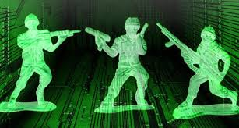
Why is cyber security important?
National Security Threat (Cyber Warfare)
Infrastructure - damage from government attacks
Economy
Finance
Image: https://vfp15.wordpress.com/2012/03/10/new-amazon-review-cyber-warfare/
Notes:
BD

Slide 3
Why is cyber security important?
Criminal Activity
Theft of financial resources/data
Theft of intellectual property
Identity Theft
Domestic Threats
Image: http://www.theexaminer.com/stories/news/%E2%80%98overwhelming%E2%80%99-task-fighting-id-theft-fraud
3
Notes:
BD

Slide 4
Why is cyber security important?
Security Breaches
Anthem
Target
Samsung
Images: http://antheminc.com/Companies/AnthemBlueCrossBlueShield/index.htm
http://www.target.com/
http://www.samsung.com/us/
Notes:
BD

Slide 5
Table of Contents
Slide Topic | Slide #
Goals and Objectives | 6
Timeline | 7
Cryptographic Systems (Private Key, Symmetric) | 8-10
Cryptographic Systems (Public Key, Asymmetric) | 11-14
Ethics | 15
Today’s Considerations | 16
Training | 17-19
Literature Review | 20
Amanda’s Unit | 21-22
Ben’s Unit | 23-24
References | 25-26
Credits | 27

Slide 6
Goals and Objectives
Goal:
Develop best practices (methodologies) for introducing students to cryptography through its mathematical foundations.
Objectives:
Research best practices in teaching/learning
Develop teacher/student friendly activities that convey the foundational concepts of cryptography
Develop units/activities rooted in mathematics and logic
Increase student interest in cryptography
Emphasize on the ethical application of cryptography
Notes:
Amanda

Slide 7
Timeline
 | Week 1 | Week 2 | Week 3 | Week 4 | Week 5 | Week 6 | Week 7
EDP & CBL
Training
Research
Unit Design
Report/ Summary
PPT
Notes:
Amanda

Slide 8
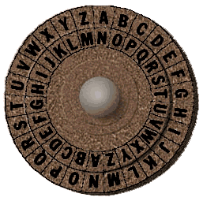
Cryptographic Systems
Private Key (Symmetric)
Permutation Ciphers
Caesar
Substitution
Enigma
XOR Cipher
AES, 3DES
Caeser cipher image:
http://www.secretcodebreaker.com/history2.html
Notes:
Amanda - Historical Consideration: Caesar Cipher, JN-25b - Midway - WWII (substitution cipher)

Slide 9
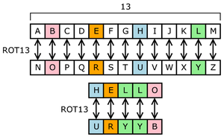
Cryptographic Systems
Private Key (Symmetric)
Permutation Ciphers
Caesar
Substitution
Enigma
XOR Cipher
AES, 3DES
Image: https://upload.wikimedia.org/wikipedia/commons/thumb/2/2a/ROT13.png/300px-ROT13.png
Notes:
Amanda - Historical Consideration: Caesar Cipher, JN-25b - Midway - WWII (substitution cipher)

Slide 10
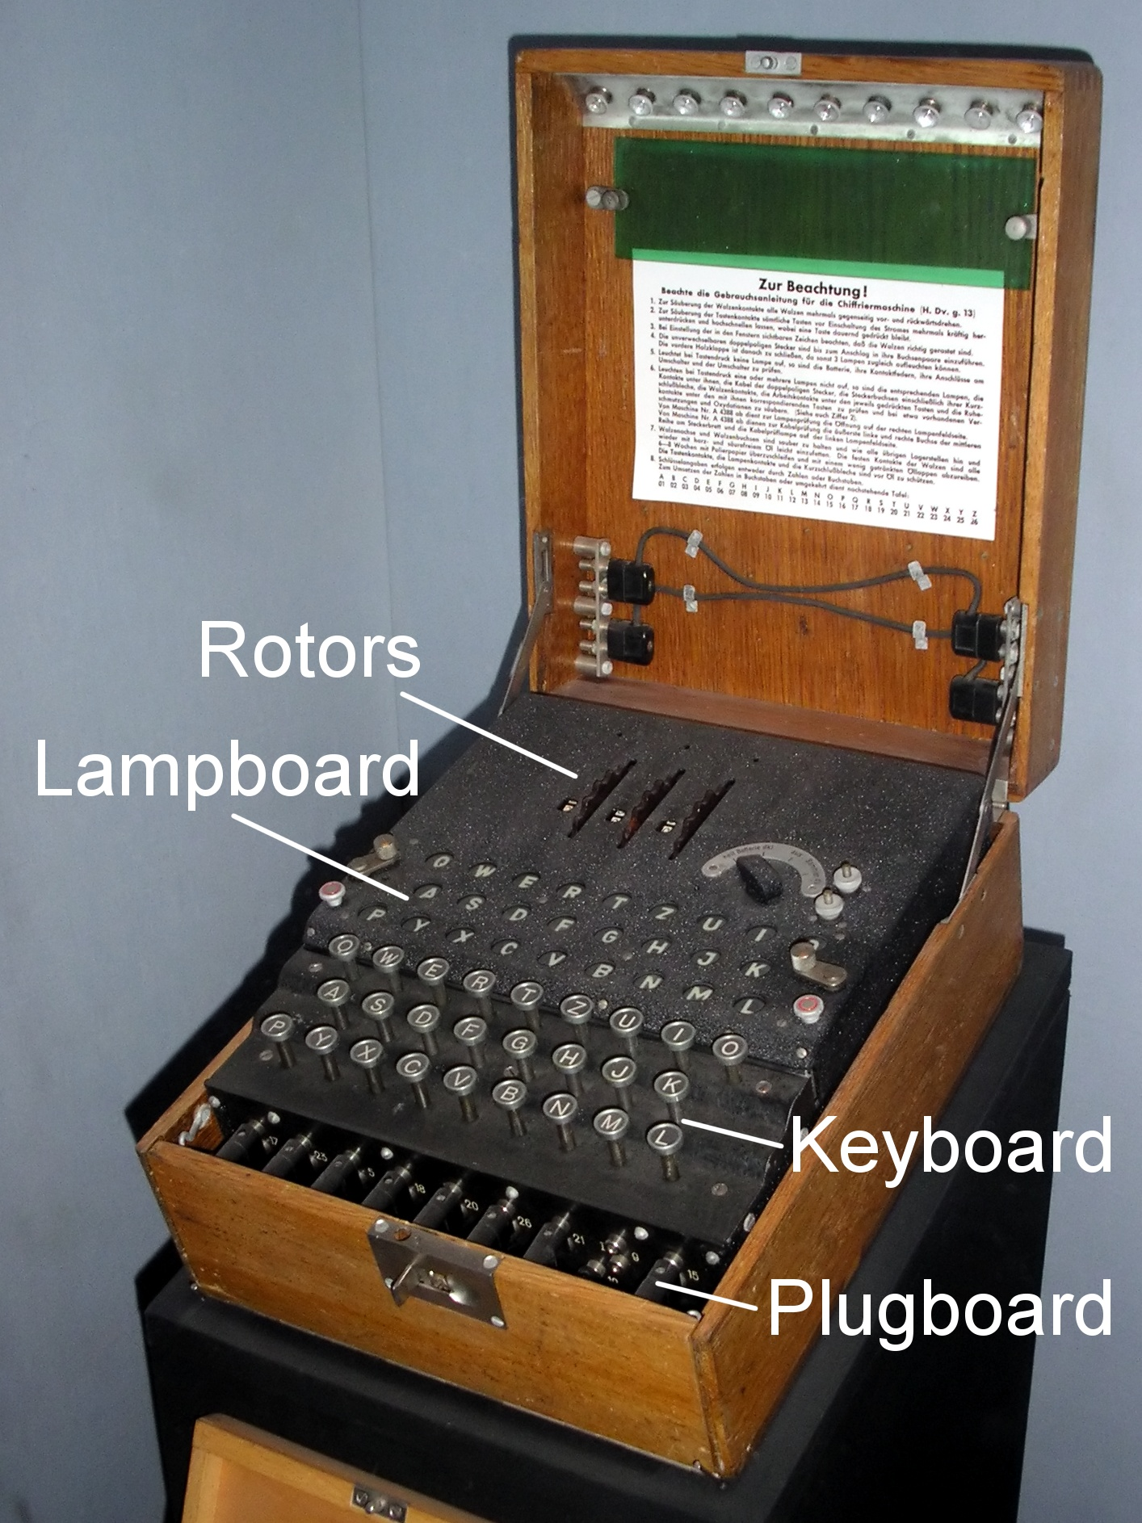
Cryptographic Systems
Private Key (Symmetric)
Permutation Ciphers
Caesar
Substitution
Enigma
XOR Cipher
AES, 3DES
Enigma Image: https://upload.wikimedia.org/wikipedia/commons/3/3e/EnigmaMachineLabeled.jpg
Notes:
Amanda - Historical Consideration: Enigma - WWII

Slide 11
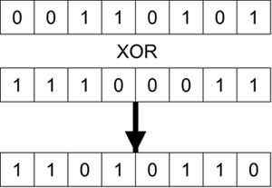
Cryptographic Systems
Private Key (Symmetric)
Permutation Ciphers
Caesar
Substitution
Enigma
XOR Cipher
AES, 3DES
Image: http://etutorials.org/Networking/802.11+security.+wi-fi+protected+access+and+802.11i/Part+II+The+Design+of+Wi-Fi+Security/Chapter+6.+How+IEEE+802.11+WEP+Works+and+Why+It+Doesn+t/Mechanics+of+WEP/
Notes:
Amanda

Slide 12
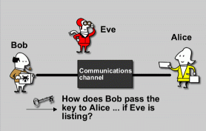
Cryptographic Systems
Public Key (Asymmetric)
Diffie-Hellman
RSA
Zero Knowledge
http://billatnapier.com/design_tips241.htm
Notes:
Ben

Slide 13
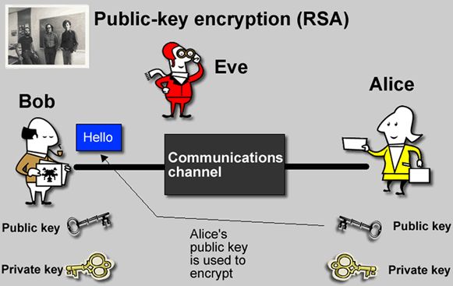
Cryptographic Systems
Public Key (Asymmetric)
Diffie-Hellman
RSA
Zero Knowledge
http://rtfq.net/security/firewall-pages/quick-and-dirty-vpn/
Notes:
Ben

Slide 14
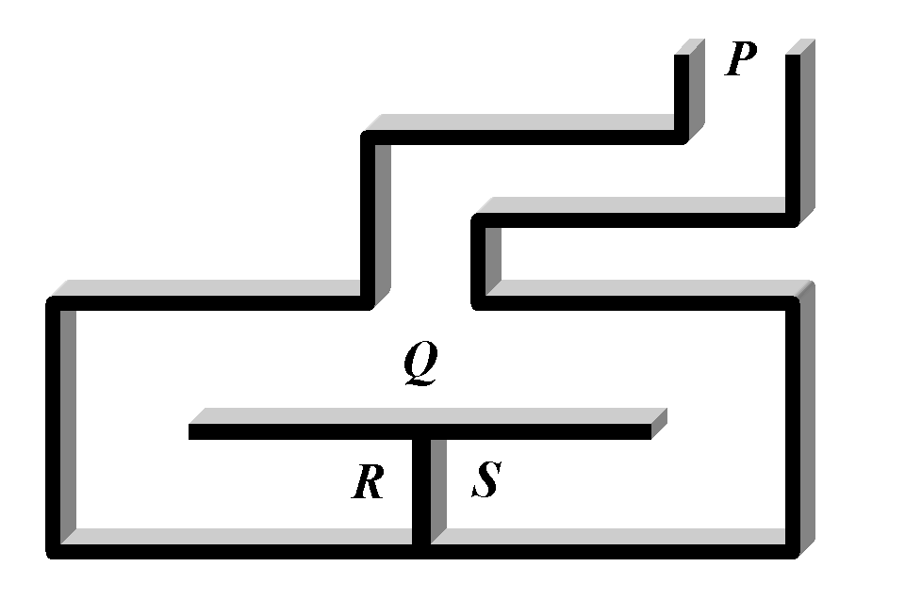
Cryptographic Systems
Public Key (Asymmetric)
Diffie-Hellman
RSA
Zero Knowledge
http://www.emc.com/emc-plus/rsa-labs/standards-initiatives/what-are-interactive-proofs-and-zero-knowledge.htm
Notes:
Ben

Slide 15
Diffie-Hellman Key Exchange
(To exchange secret keys for Symmetric ciphers)
Public:
p: 23, g: 5
Alice
Bob
Chooses secret integer a=6
Chooses secret integer b=15
Computes 5⁶ mod 23 = 8
Computes 5¹⁵ mod 23 = 19
Alice sends 8 to Bob
Alice computes secret key: 19⁶ mod 23 = 2
Bob computes secret key: 8¹⁵ mod 23 = 2
Bob sends 19 to Alice
Shared secret is 2!
Notes:
BD

Slide 16
RSA Algorithm
(to exchange information using Asymmetric ciphers)
Public Information:
Prime numbers p & q
p = 61, q = 53
Calculate n = p * q = 3233
Totient, Ø(n) = (p-1)*(q-1) = 3120
Alice
Choose encryption key, e, such that it is coprime to Ø(n)
We choose e=17
Choose decryption key d such that e*d mod Ø(n) = 1
Solving 17*d mod Ø(n) =1, we get d = 2753
Public key: (e,n) :: (17, 3233)
Private key: (d,n) :: (2753, 3233)
Notes:
BD

Slide 17
RSA Algorithm
(contd..)
Alice’s public key: (e,n) :: (17, 3233)
Alice’s private key: (d,n) :: (2753, 3233)
Bob wants to send message, m = 123, to Alice. He uses Alice’s public key (17, 3233).
Bob calculates ciphertext, c = m^{e} mod n = 123¹⁷ mod 3233 = 855
Sends 855 to Alice
Alice gets 855 and decrypts it using equation, m = c^{d} mod n
= 855²⁷⁵³ mod 3233
= 123
Thus, Alice receives the message securely from Bob
Notes:
BD

Slide 18
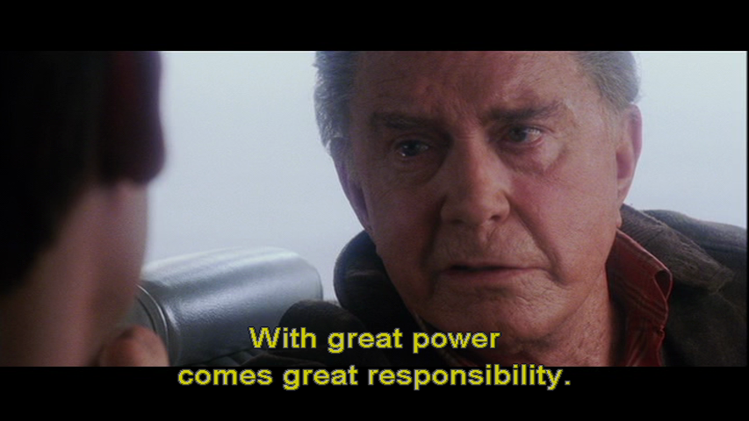
Ethics
Zimmerman Telegram - WWI
Coventry Dilemma - WWII
Discovery/Notification of Bugs
Images: https://thisfangirlsperspective.wordpress.com/2014/06/15/tfp-presents-our-four-favorite-dads/
Notes:
Ben

Slide 19
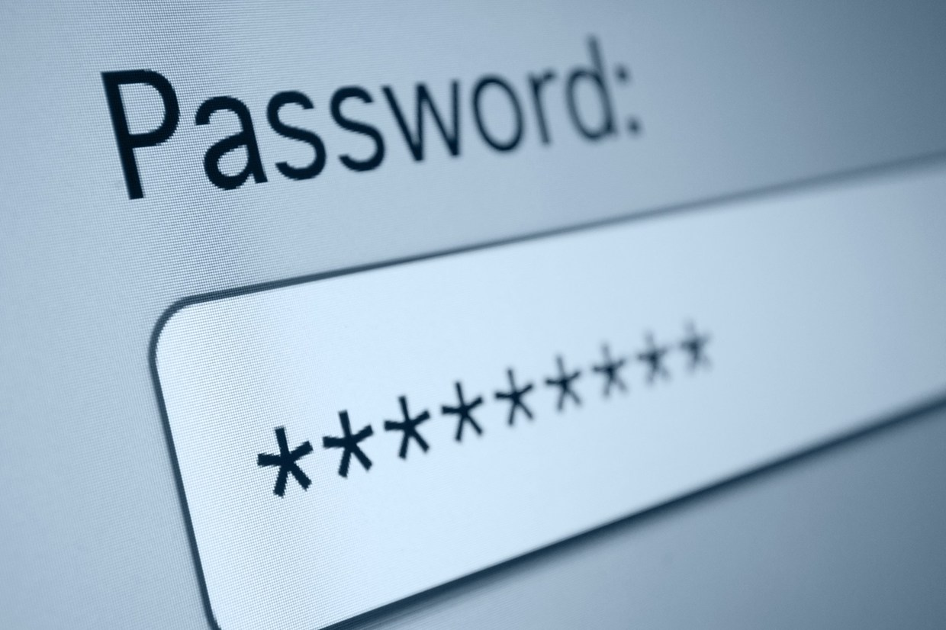
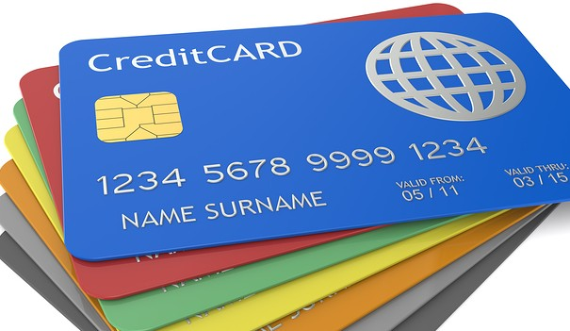
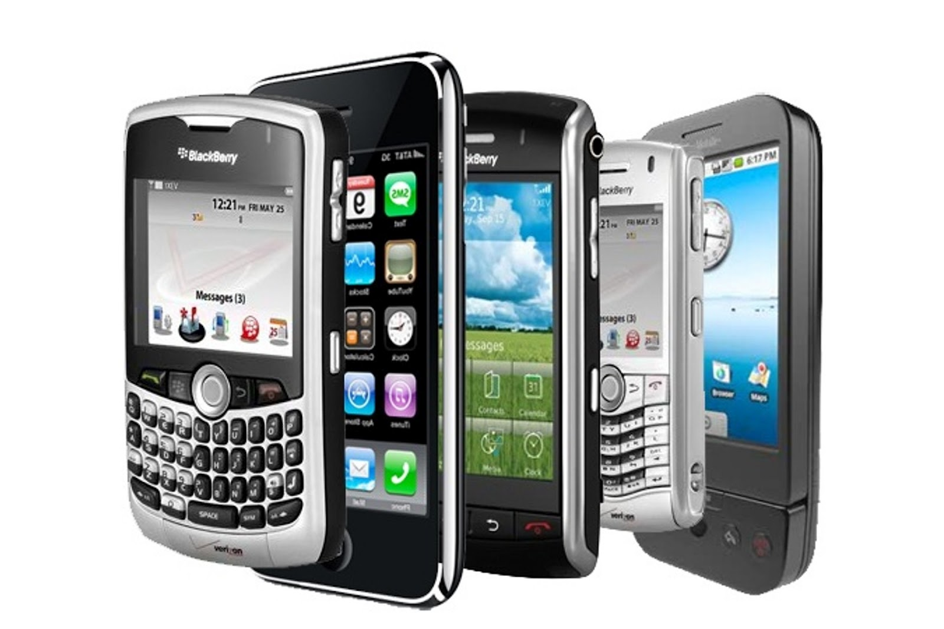
Today’s Considerations
http://www.wired.co.uk/
Cell Phones
Bank/Credit Card Information
Health Care
Passwords
Online Purchases
http://www.lowcards.com/
http://finance.yahoo.com/
http://www.climasyseng.com/
http://drleonardcoldwell.com/
Notes:
BD

Slide 20
Training
Image: http://civilblog.org/2015/02/07/how-to-check-quality-of-bricks-on-site/
Notes:
Amanda

Slide 21
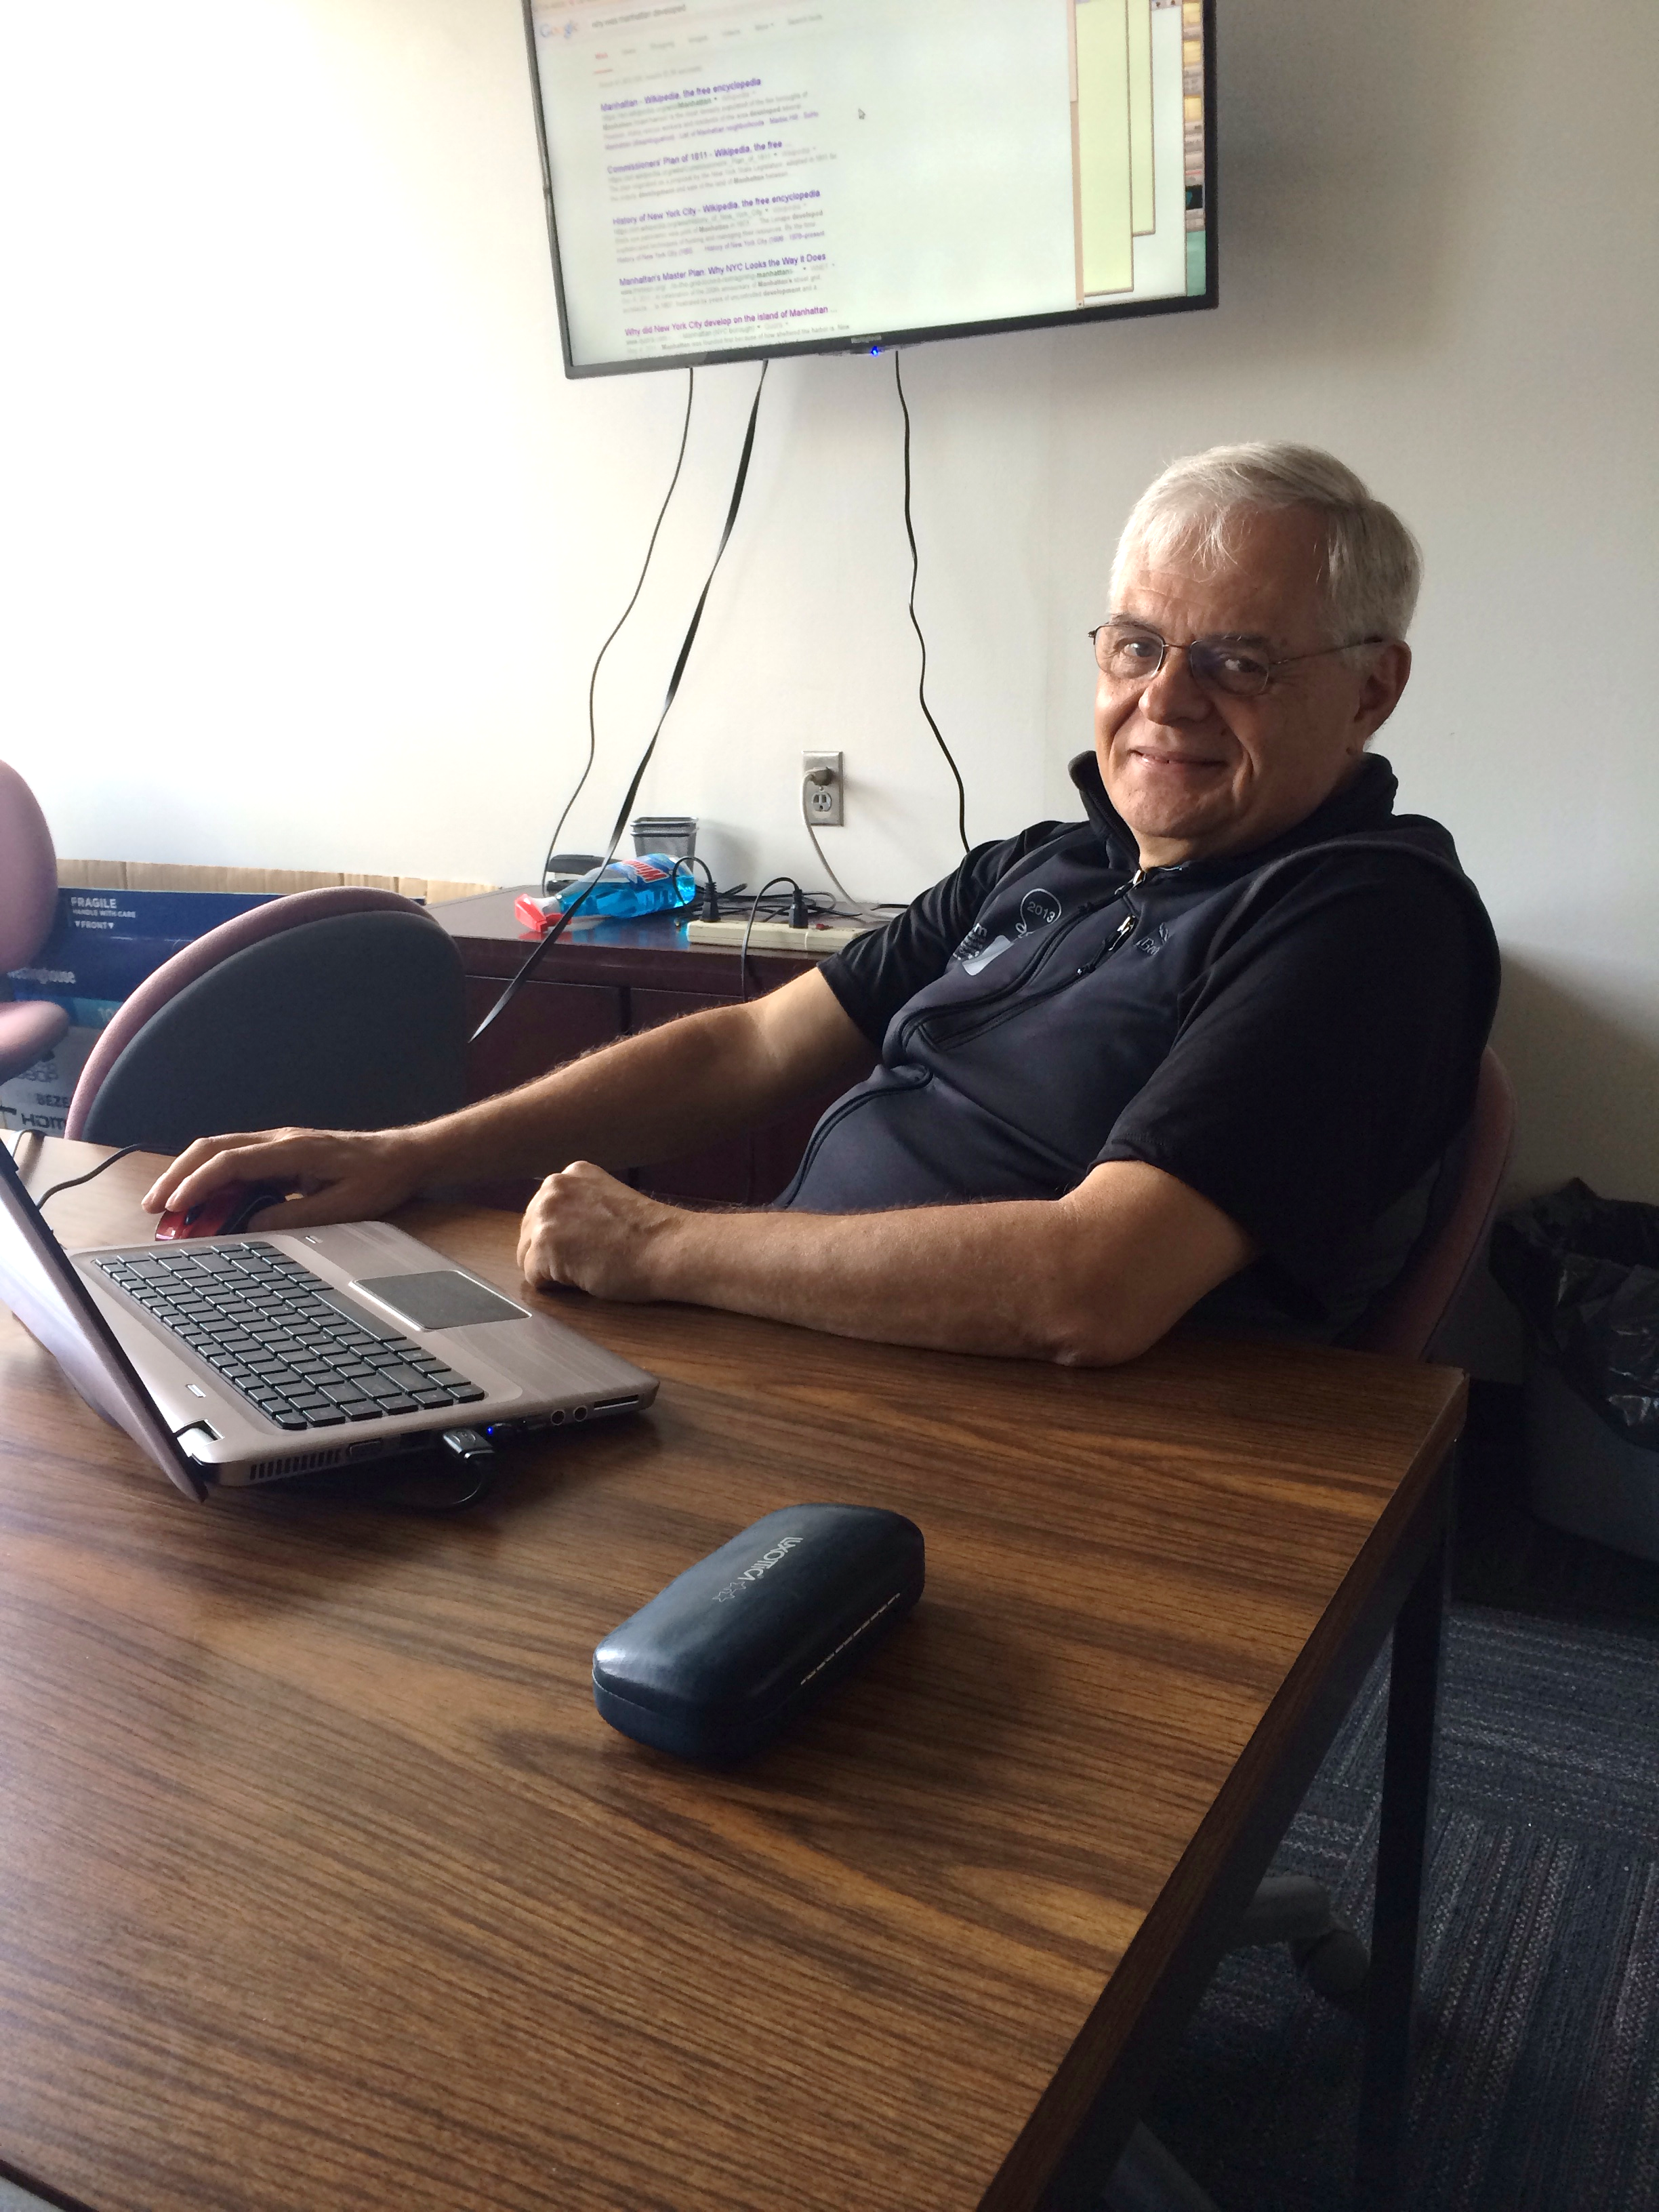
Training
Foundations of computer programming (Java)
Cryptographic Systems Training:
Substitution Ciphers
Diffie-Hellman
Public Key Cryptography (RSA)
Protocols
Authentication
Message Integrity
Notes:
Amanda

Slide 22
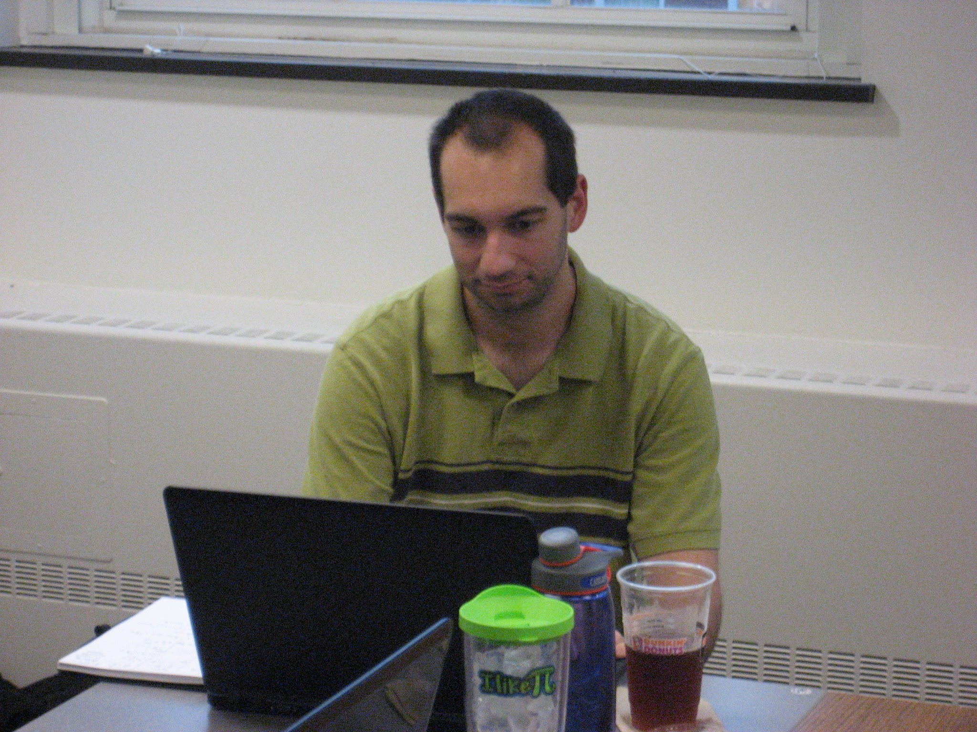
Training
Mathematics:
Modular Arithmetic
Euclid’s GCD Method
Chinese Remainder Theorem
XOR
Notes:
Amanda

Slide 23
Literature Review
Combining pen & paper and technology cryptographic methods
Math Instruction vs. Cryptography Instruction
Benefits of early career awareness
Lack of teacher knowledge limits buy-in
Image: http://pfl.grad.ncsu.edu/workshops/fit-fundamentals-in-teaching/
Notes:
Amanda

Slide 24
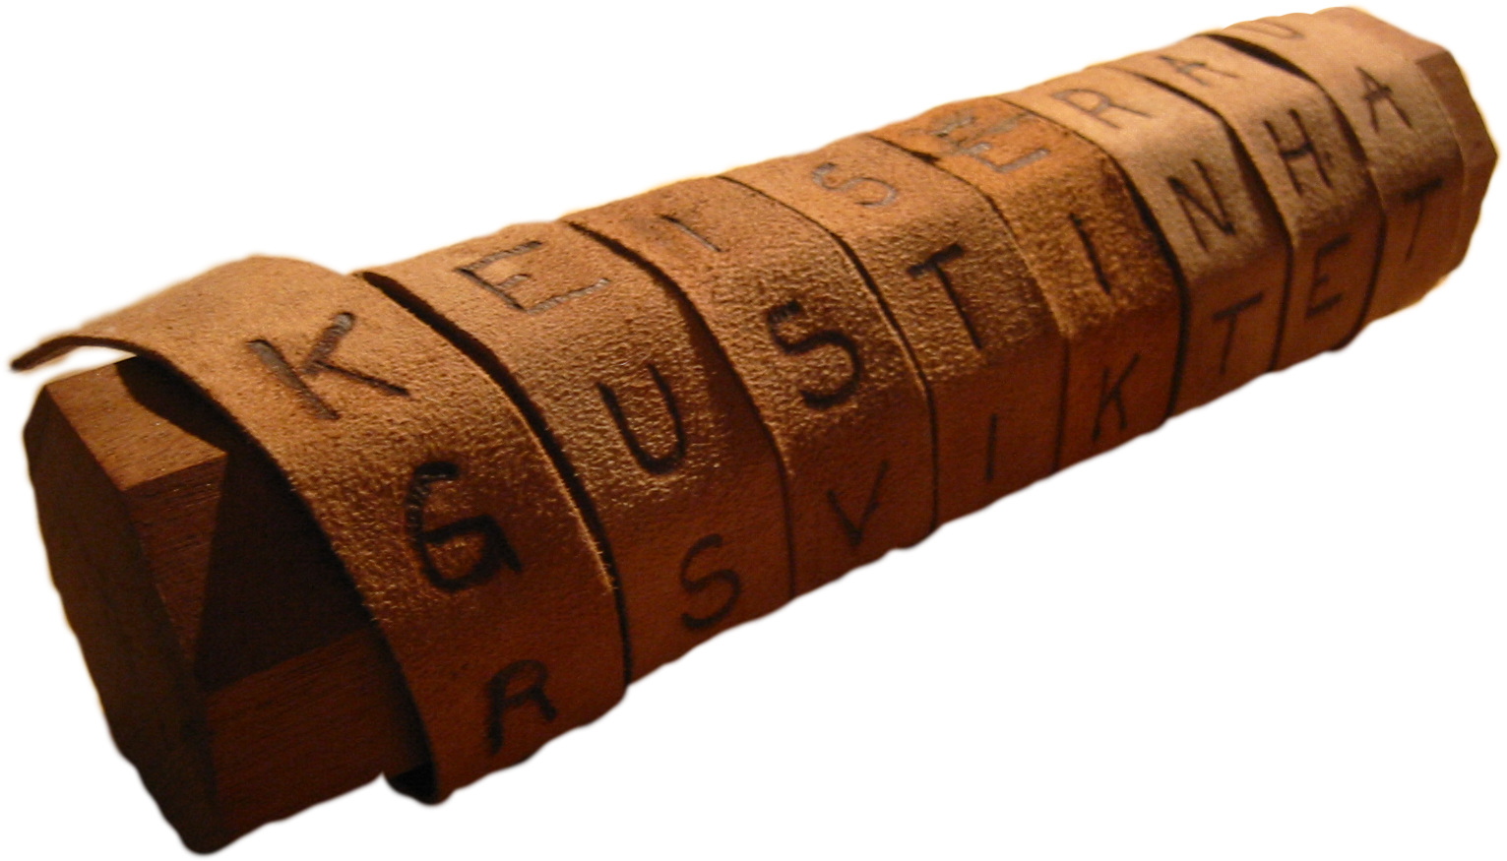
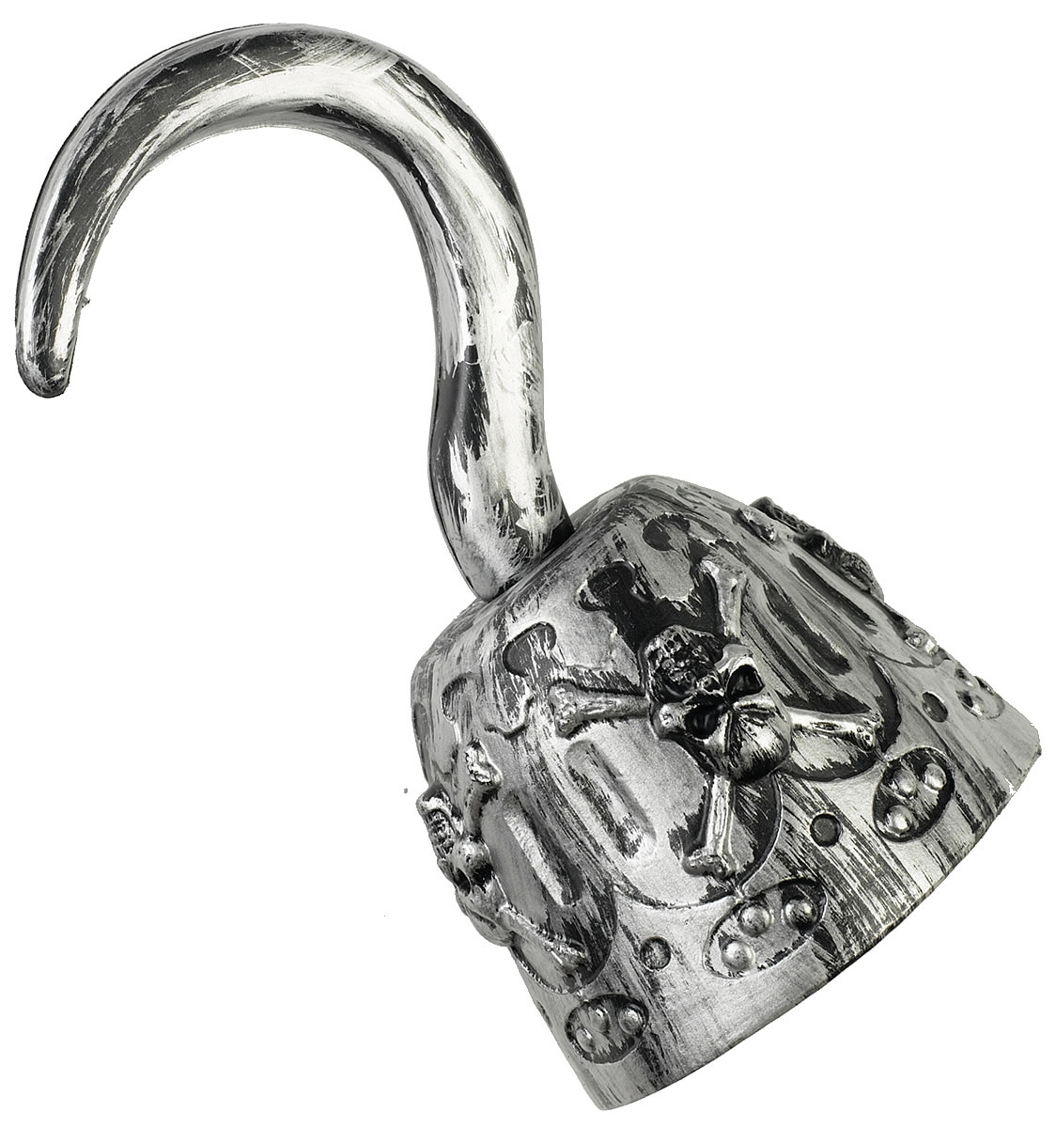
Amanda’s Unit Overview
6th Grade Mathematics
Big Idea: How do I keep a secret?
https://en.wikipedia.org/wiki/Scytale
Essential Questions:
How is cryptography used in my everyday communications?
What mathematics is used in cryptography?
How do you encrypt/decrypt data?
How do hackers steal data?
How can I protect my data and communications?
http://www.halloweenmart.com/accessories/pirate/Pirate-Hook.html
Notes:
Amanda

Slide 25
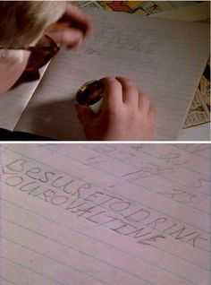
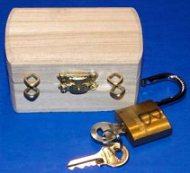
Amanda’s Unit Overview
Challenge
ETHICS
Images: https://www.pinterest.com/makebelieveart/hieroglyphs-secret-codes/
http://www.emc.com/emc-plus/rsa-labs/standards-initiatives/what-are-interactive-proofs-and-zero-knowledge.htm
http://ip2consulting.com/career/ethics.html
Notes:
Amanda

Slide 26
Ben’s Unit Overview
Mathematics, Grade 11-12
Big Idea: Cyber Security
Essential Questions:
How can we communicate secure information?
How do we know who’s at the other end of an encrypted channel?
How is cryptography used in the world historically and at present?
What mathematics underpin cryptography?
Image: https://www.zen.co.uk/blog/cyber-security/
Notes:
BD

Slide 27
Ben’s Unit Overview
Challenge: War Games
Students will work in teams to play a simulated war game that will require them to send encrypted messages to their team as well as to break the “enemy” codes to locate the enemy, launch attacks, and reposition tactical resources.
Image: http://feltron.tumblr.com/post/78854599322/war-games
Notes:
BD

Slide 28
References
Bachman, D.J.,Brown, E. A.,and Norton, A.H. (2010). "Chocolate Key Cryptography." Mathematics Teacher, 104(2), 100-104.
Beutelspacher, A (1994). Cryptology: An introduction to the Art and Science of Enciphering, Encrypting, Concealing, Hiding and Safeguarding Described Without any Arcane Skullduggery but not Without Cunning Waggery for the Delectation and Instruction of the General Public. The Mathematical Association of America, Washington, D.C.
Dowling, T. (2006). “The Design and Evaluation of a Cryptography Teaching Strategy for Software Engineering Students.” European Journal of Engineering Education, 31(5), 593-606.
Hall, M. (2003). "Sharing teaching ideas: Calculator cryptography." The Mathematics Teacher, 96(3), 210-212.
Holden, J. (2004). “A Comparison of Cryptography Courses.” Cryptologia, 28(2), 97-111.
Holden, J., Layton, R., Merkle, L., Hudson, T. (2006). “Underwater Hacker Missile Wars: A Cryptography and Engineering Contest.” Cryptologia, 30(1), 69-77.
Hsin, W. (2005). "Teaching Cryptography to Undergraduate Students in Small Liberal Art Schools." Proceedings of the 2005 Information Security Curriculum Development Conference: September 23-24, 2005, KSU Center, Kennesaw State University Kennesaw, GA, 38-42.
Katz, F.H. (2014). “A Comparison of Different Methods of Instruction in Cryptography.” Information Security Curriculum Development Conference, Kennesaw, GA.
Konak, A. (2014). “"A cyber security discovery program: Hands-on cryptography”, 4th IEEEIntegrated STEM Education Conference, Princeton, NJ.

Slide 29
References
Leward, R. (2007). “Cryptology in a Liberal Arts Setting.” Mathematics and Computer Education, 41(3), 211-218.
Schembari, P. (2007). “’Hands-On Crypto’: Experiential Learning in Cryptography.” Proceedings of the 11th Colloquium for Information Systems Security Education: June 4-7, 2007, Boston University, Boston, MA, 7-13.
Sikha, O., Kuchithra, M., Prabha, P., Soman, K.P. (2014). “An Interactive Visualization Tool for the Interpretation of Mathematical Concepts behind Public Key Cryptography.” International Journal of Computer Applications, 90(5), 36-39.
Singh, S. (1999). The Code Book: The Science of Secrecy from Ancient Egypt to Quantum Cryptography. Doubleday, New York, NY.
Trigui, M., Daniyal, A. (2012). “Learning the Related Mathematics to Cryptography by Interactive Way.” International Journal of Modern Education and Computer Science, 2, 8-14.
Wood, C., Kaszubowski, Y. (2008). "The Career Development Needs of Rural Elementary School Students." The Elementary School Journal, 108(5), 431-444.
Yan, L. (2007). “Teaching Cryptography Activity in Taiwan’s High Schools.” Supporting Learning Flow through Integrative Technologies, IOS Press, 553-560.
Yang, L., Kizza, J., Wang, A., Chen, C.H. (2011). “Develop Case Studies to Teach Cryptography in a Collaborative Environment.” Proceedings of the 2011 International Conference on Frontiers in Education Computer Science & Computer Engineering, 2011 International Conference on Frontiers in Education Computer Science & Computer Engineering: July 18-21, 2011, Las Vegas, NV, 542-544.

Slide 30
Credits
Special thanks to:
Dr. John Franco
Amin Makani
Nick Maltbie
Dr. Kukreti
Debbie Liberi and David Macmorine
RET is funded by the National Science Foundation grant number: EEC-1404766

